Slide 1
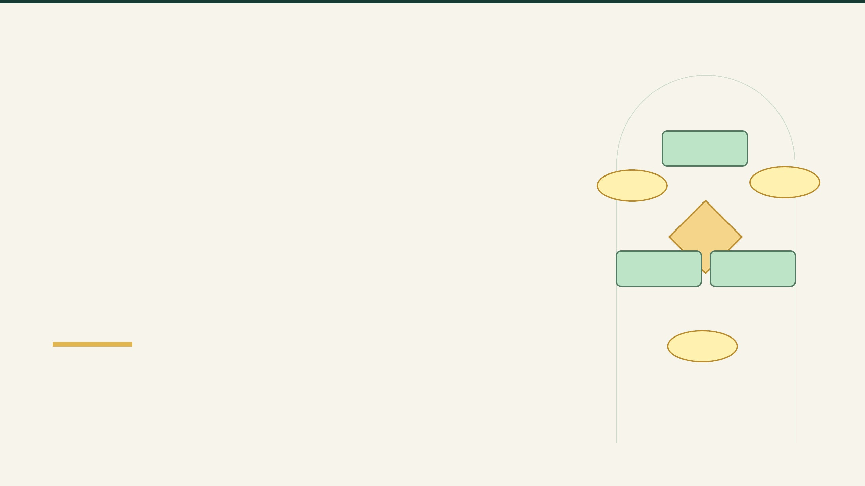
DATABASE ARCHITECTURE / ER MODEL
E-Commerce Order, Return & Refund
A visual map of customers, products, orders, returns, and refunds — connected through a clear relational structure.
ENTITY–RELATIONSHIP DIAGRAM
01 | SYSTEM BLUEPRINT

Slide 2

ENTITIES & ATTRIBUTES
Database entities and the attributes stored for each one
CUSTOMER
Customer_ID (PK)
Name
Email
Phone
Address
ORDER
Order_ID (PK)
Customer_ID (FK)
Product_ID (FK)
Order_Date
Quantity
Total_Amount
Status
PRODUCT
Product_ID (PK)
Product_Name
Price
Stock
RETURN
Return_ID (PK)
Order_ID (FK)
Return_Date
Reason
Status
REFUND
Refund_ID (PK)
Return_ID (FK)
Refund_Date
Amount
Status
PK = Primary Key • FK = Foreign Key
02 | SYSTEM BLUEPRINT

Slide 3
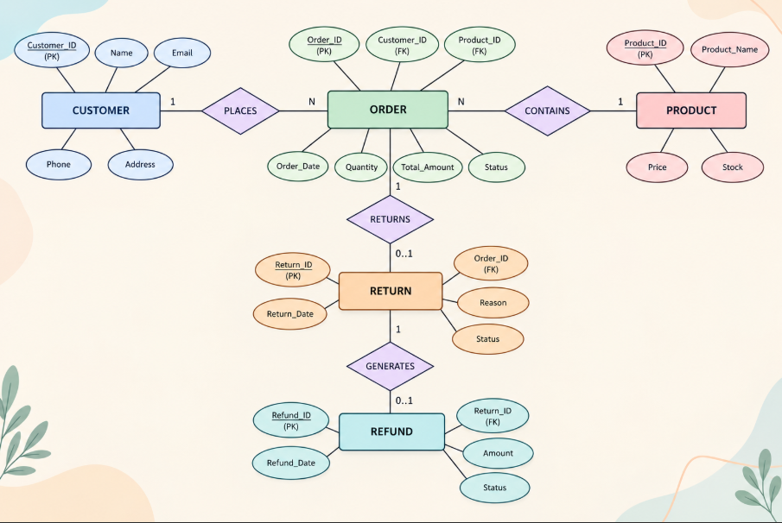
ENTITY–RELATIONSHIP DIAGRAM
E-Commerce Order, Return & Refund
03 | SYSTEM BLUEPRINT

Slide 4
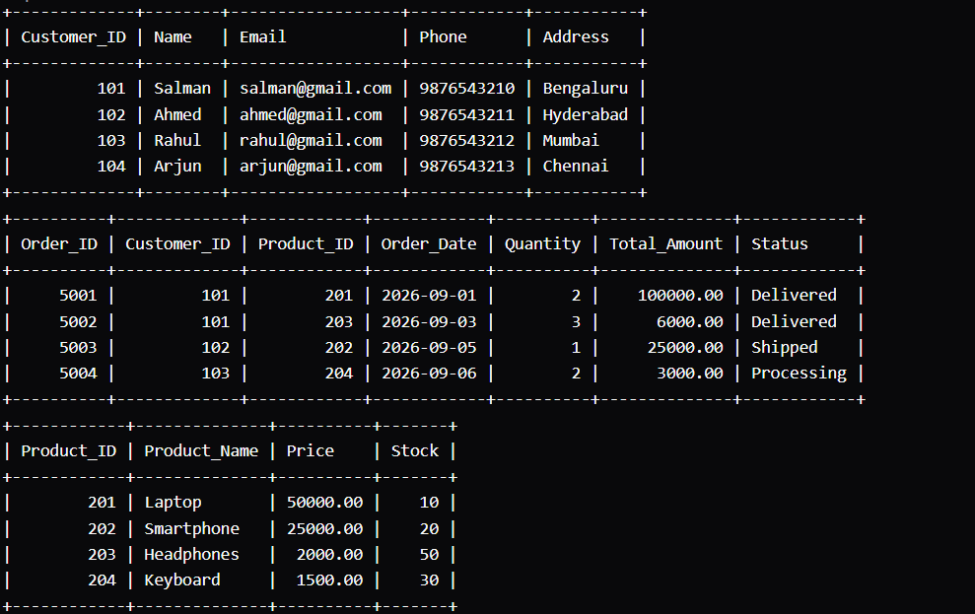
DATABASE TABLES
Customer and Product data

Slide 5
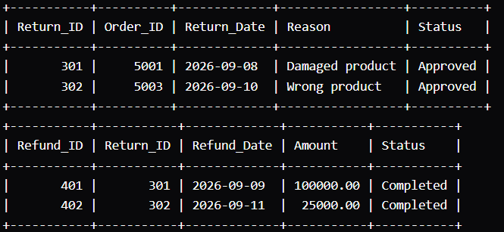
DATABASE TABLES
RETURN & REFUND

